Slide 1
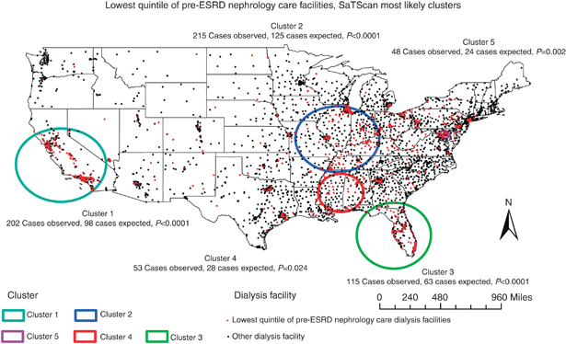
Other Datasets with Hidden Structures

Slide 2
MKT 591: Course Roadmap
Review of Quant Market Research
Prediction / Regression
Forecasting
Features & Dimensions
Market Segmentation
Simple Linear Regression
Demand Forecasting
Customer Classification
Factor Analysis
Segmentation General
Measurement Scales
Categorical Variables
BASS Diffusion Model
Discriminant Analysis
MDS
Advanced Model-based Segmentation
Discrete Analysis (CrossTab)
Extracting Features by Text Analytics
Multiple Regression
Bayesian Classifier
Spatial Analysis
Continuous Analysis (Correlation)
Issues in Regression
Tree Models
Deep Learning
Logistic Regression (Consumer Choice)
Bayesian Statistics

Slide 3
Spatial Data in Marketing
Recently, the availability of spatial data has boomed.
Developments in geographic systems (e.g., GIS or GPS).
Mobile technology enables to easily track the location information of mobile users (consumers).
Easy to search location information or IP address in internet.
Online (review) sites providing address/location information of business units (e.g., restaurants, car dealerships, hotels).
Empirical modeling for analyzing spatial data are still relatively new in Marketing (see Bradlow et al. 2005; Bronnenberg 2005).

Slide 4
Brief Spatial Literature in Marketing
Importance of geographic proximity
Proximity effects are significant in the initial phase of the new product launch – packaged goods (Bronnenberg and Mela 2004)
Proximity effects is important to product adoption and demand evolution in the early phases – Online Retailer(Bell and Song 2007, Choi et al. 2008)
Problem
Linear fitting of spatial data ignore dependence structure of error

Slide 5
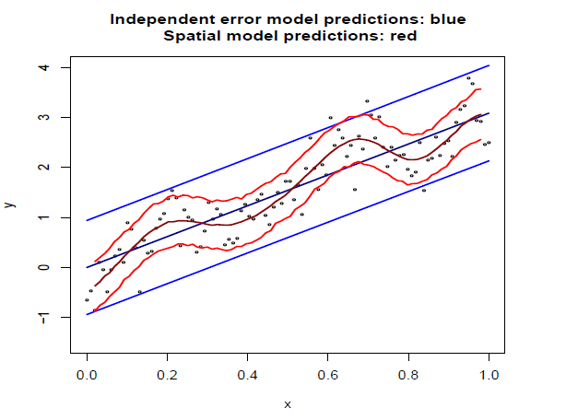
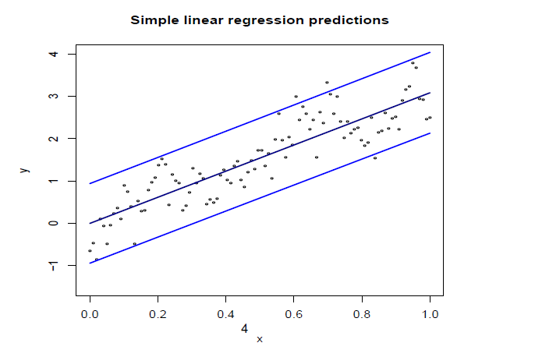
Spatial Models in Marketing

Slide 6
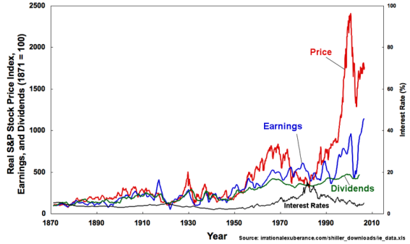
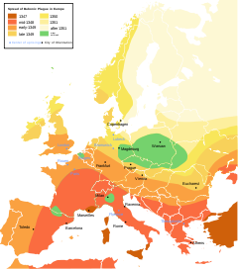
Spatial Models in Statistics
Markov Chain Model
One time dependence
t-1
t
Stochastic Model
Multiple time dependence
E.g., Exponential Smoothing
Spatial model
Multi-dimensional multiple point (SPATIAL) dependence
Distance and directions

Slide 7
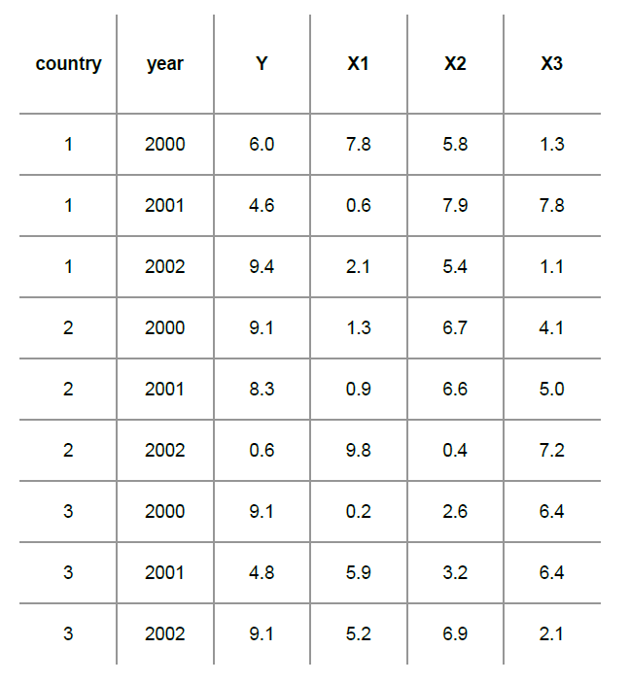
Time Series Analysis Example (Panel Analysis)
This is a semester topic in Econometrics… ☺
Sample data pattern
E.g., Multiple years and multiple countries
Aggregated countries → cross-sectional data

Slide 8
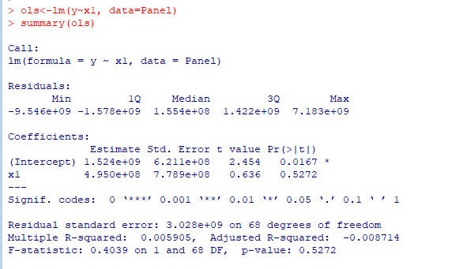
OLS results with Panel data
Regular OLS does not consider heterogeneity across groups (countries) or time (year)

Slide 9

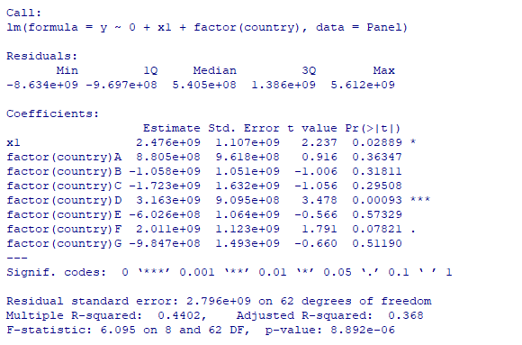
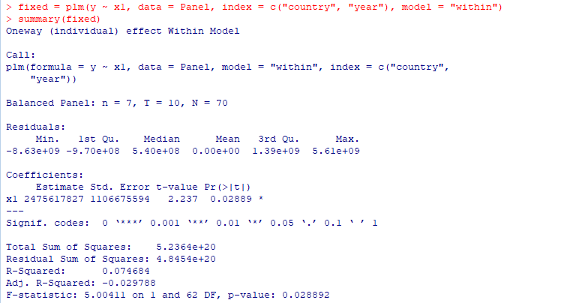
Fixed Effect model with Panel data
Focusing on the impact of variables (here X1) that vary over time.
Controlling for groups (countries) effects – including regression

Slide 10
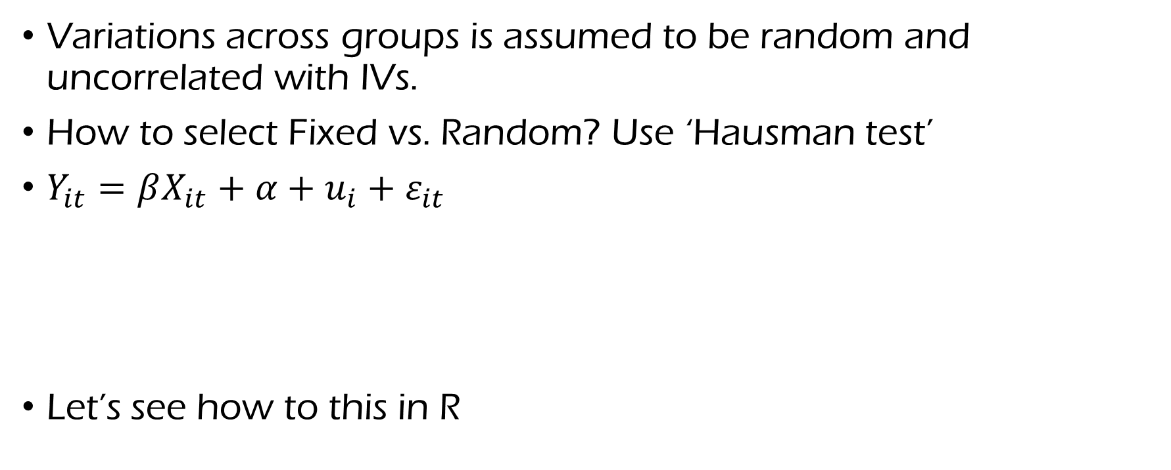
Random Effect model with Panel data
Variations across groups is assumed to be random and uncorrelated with IVs.
How to select Fixed vs. Random? Use ‘Hausman test’
$Y_{it}=βX_{it}+α+u_{i}+ε_{it}$
Let’s see how to this in R
Within-group error
Between-group error

Slide 11
Spatial Models in Statistics
Problem
Can we assume the data is iid? Or, is there any hidden data structure?
Spatially dependent (Very Rarely independent and identically distributed (iid))
Application
Environmental Science, Biology, Marketing…
Three types of spatial models
Geostatistical models (continuous)
Lattice (areal) models (discrete)
Spatial point processes models (point process)

Slide 12
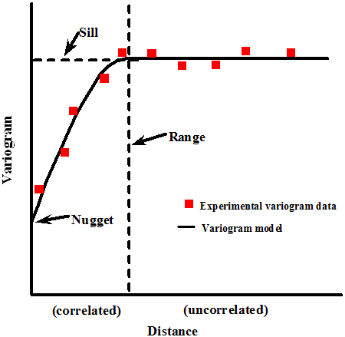
Spatial Models in Statistics
(1) Geostatistical models
Identify Variance (Variogram) of difference between field values at two locations: Lower distance, more correlated.
Example
Kriging: Named after D.G. Krige, South African mining – Developed for finding diamond mines
Spatial Autoregressive Model
Notes:
Covariance structure– please check this!

Slide 13
Spatial model example in R (Spatial Autoregressive Regression)
Spatial AutoCorrleation (Moran’s I)
https://en.wikipedia.org/wiki/Moran%27s_I
Let’s compare Spatial Autoregressive Regression results with LM

Slide 14
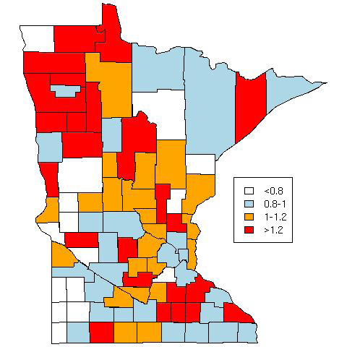
Spatial Models in Statistics
(2) Lattice (Areal) Model
Block-level processes
Example of models
Adjacency Structure (network model)
Markov Random Field Model

Slide 15
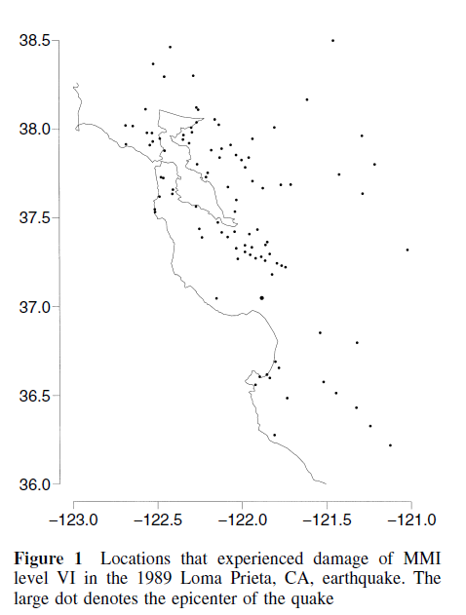
Spatial Models in Statistics
(3) Point Process Models
Spatial Poisson processes
E.g., Ripley’s K function
(Guttorp et al., 2002)

Slide 16
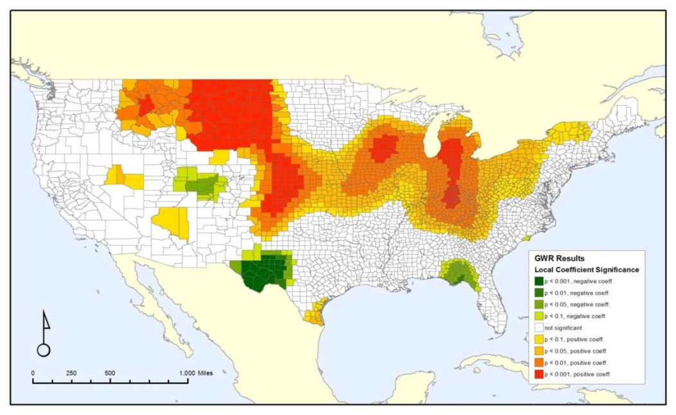
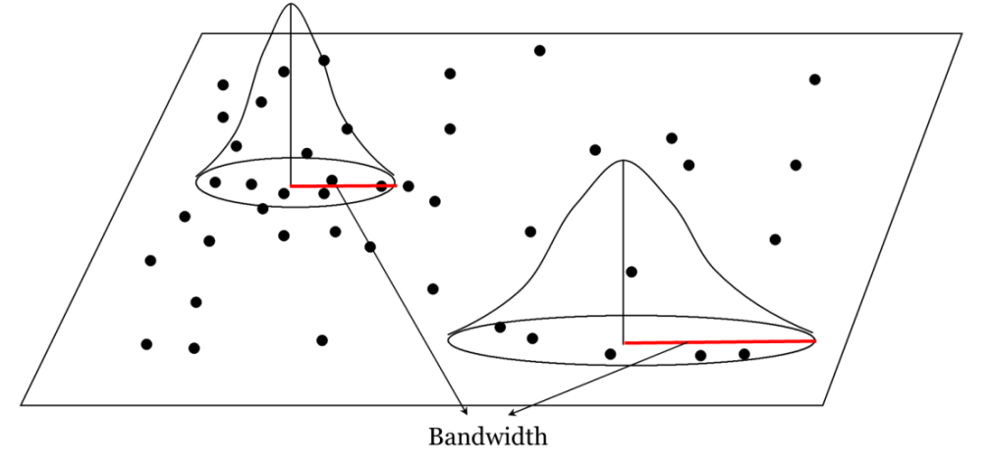
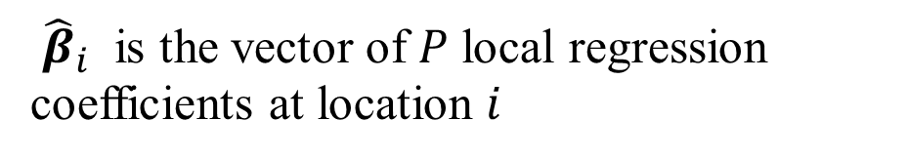


In this class: Geographically Weighted Regression (GWR) for spatial heterogeneity
GWR model: To understand Spatial Pattern of Regression Coefficients (Brunsdon, Fotheringham, and Charlton 1996). – Varying coefficients across map!
Near observations- larger weights; far observations- smaller weights at a focal location…
$${\hat{β}}_{i}={\left(X^{T}W_{i}X\right)}^{−1}X^{T}W_{i}Y.$$
$$\left.W_{i}=diag[w_{i1}, ⋯w_{ij},…, w_{in}\right]$$
${\hat{β}}_{i}$ is the vector of $P$ local regression coefficients at location $i$

Slide 17
Geographically Weighted Regression (GWR) in Marketing
Heterogeneous pattern of coefficients on dependent variable (e.g., customer satisfaction) over the map.
Across multiple independent variables, it provides what are key drivers across different regions.
Coefficients for importance of dealership services (Mittal, Kamakura and Govind, Journal of Marketing, 2004)

Slide 18
GWR Practice in R
Let’s practice this GWR model using R.
I collected EU restaurants data from TripAdvisors.
It includes Overall Quality/Satisfaction (DV), Food scores, Service scores and Value scores (IVs).
As a example let’s run GWR only with restaurants in Belgium.

Slide 19
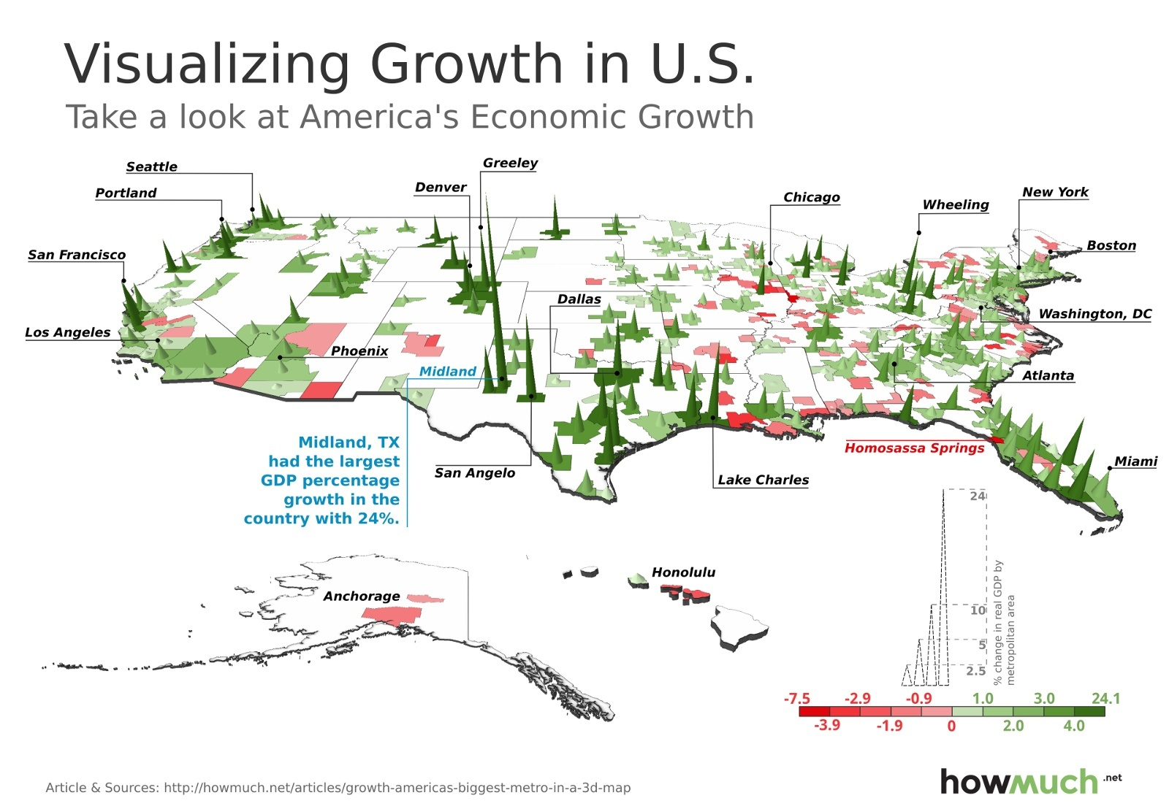
Modeling of Spatially Dependent and Heterogeneous Geographical Regions Sunghoon Kim (with Wayne S. DeSarbo, Won Chang)

Slide 20
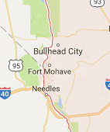
Why New GWR model?
Irregularity of the observed data: sparse observations in some areas but dense observations in other areas –Let’s combine state-level information to local information (hierarchical structure modeling)
Boundary effects: the effect of a unit distance might be different due to state boundaries (e.g., Irmak, Naylor, and Bearden 2011)
Nevada
?
Arizona
California

Slide 21
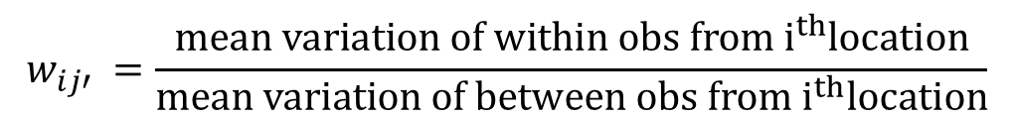
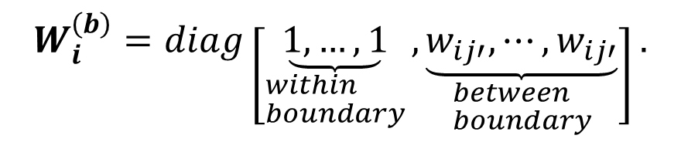
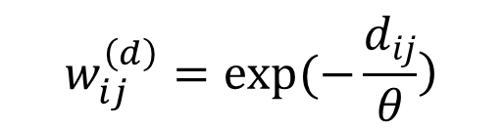
Weight Matrix of The HBGWR Model
The NEW GWR Model
Boundary Weight Matrix
$$W_{i}^{\left(b\right)}=diag\left[\underset{\begin{aligned}&within \\ &boundary\end{aligned}}{\underbrace{1,…,1}}, \underset{\begin{aligned}&between \\ &boundary\end{aligned}}{\underbrace{w_{ij′},⋯, w_{ij′}}}\right].$$
Classic Distance Weight Matrix
$$\left.w_{ij}^{\left(d\right)}=exp⁡(−\frac{d_{ij}}{θ}\right)$$
$$w_{ij′} =\frac{mean variation of within obs from i^{th}location}{mean variation of between obs from i^{th}location}$$
Distance between i and j
Bandwidth parameter

Slide 22
The Hierarchical Bayes GWR Model
Hierarchical (e.g., State-level) p^{th} regression coefficient
Even when all locations have only one observation, HBGWR model can combine hierarchical (state-level or nation-level) effects with locally weighted multiple observations by using this prior equation.
The Bayesian hierarchical setting has a nice fit with this spatial modeling setting for improvements.

Slide 23
Application Study One: AUTOMOBILE CUSTOMER SATISFACTION STUDY
Customer service satisfaction study data used in Mittal, Kamakura, and Govind (2004) – It has multiple observation(s) per zip region
Satisfaction survey with customers who have owned their vehicle for up to 33 months and who have had their vehicle serviced at an authorized dealership in the past 6 months
Ten-point scales (1 = “extremely dissatisfied”, 10 = “extremely satisfied”): “On the basis of your experience this far, how would you rate your satisfaction with overall vehicle ownership experience (overall satisfaction), dealership service (service), and vehicle quality (quality)?”

Slide 24
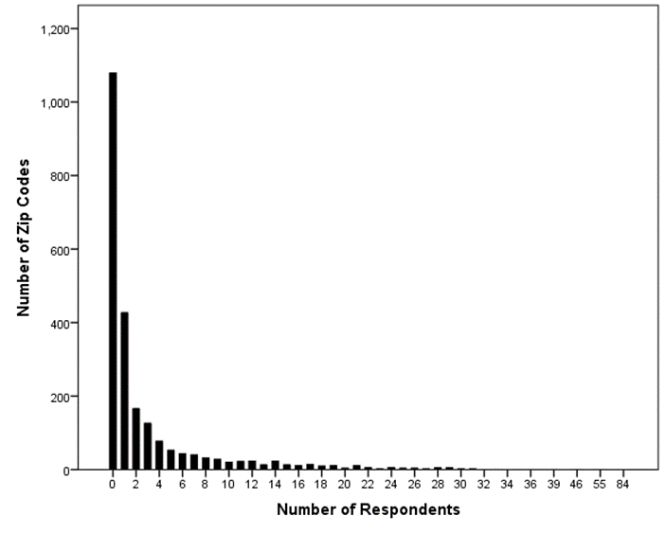
Frequency of Respondents by Zip Code
Number of respondents in the mountain division = 8,797; the number of total Zip codes in the Mountain division = 2,405; the number of Zip codes in Mountain division available in the data = 1,330.
The observation pattern in this dataset is irregular; Some areas have very sparser observations!

Slide 25
Predictive Validation Study across multiple models
 | Zip-level Linear Regression | K=4 by Spatially Dependent Segmentation (Govind et al. 2018)* | GWR | The Proposed HBGWR Model
Mean Square Prediction Error | 3.41 | 1.103 | 1.047 | 0.865
MAE | 1.03 | 0.703 | 0.68 | 0.56
Interval range of predicted value averaged across all areas | 5.22 | 3.6 | 4.96 | 3.66

Slide 26
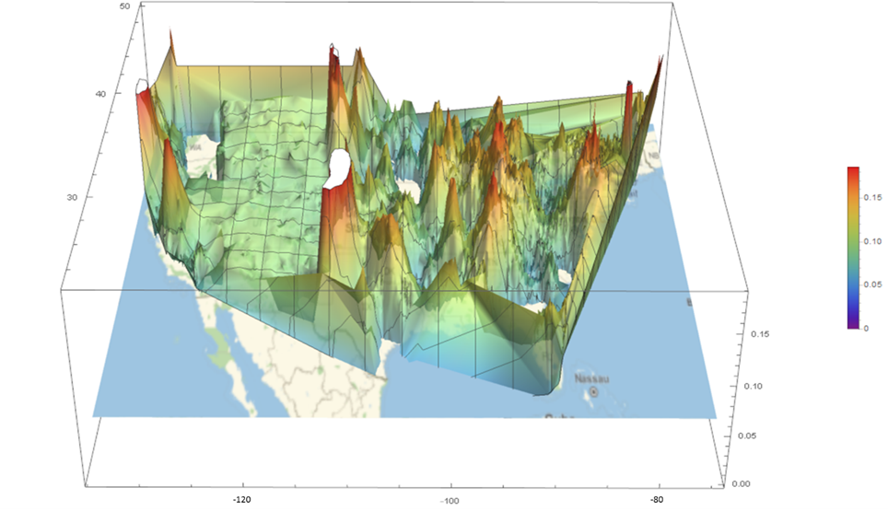
(A) Coefficients of Dealership Service by using the new model
Negative Coefficients are hidden below the US map in the 3-D graphic (e.g., WA)

Slide 27
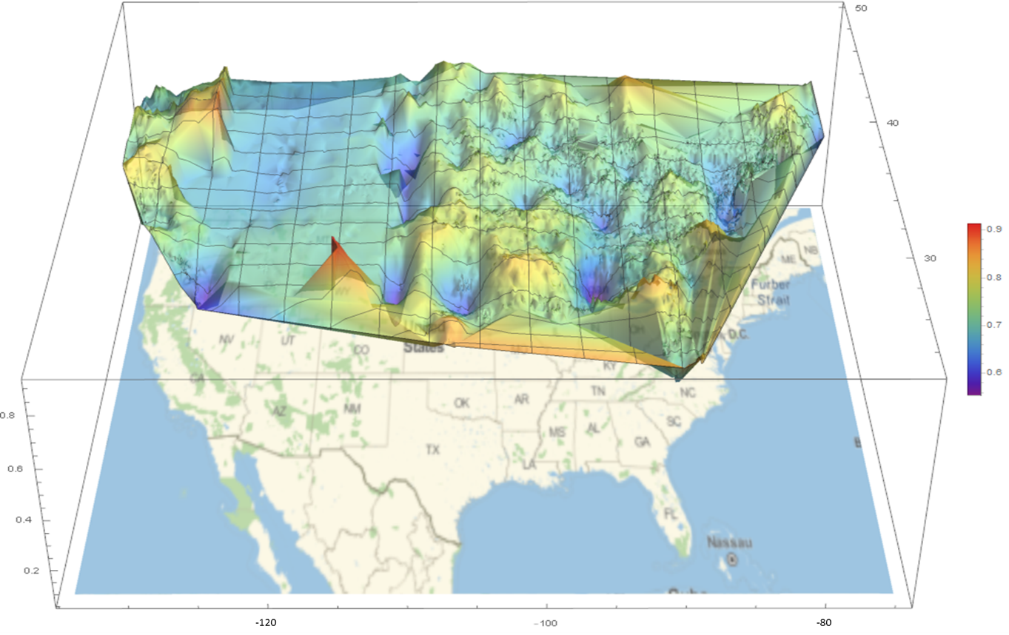
(B) Coefficients of Vehicle Quality by applying the new model

Slide 28
Application Study Two: CONSUMER SATISFACTION REVIEWS OF EUROPEAN RESTAURANTS
This type of review data (e.g., restaurants, hotels, car dealers, hospitals, etc.) have become widely available with location information (e.g., address).
Collected all restaurant reviews from TripAdvisors.com for six EU countries: Belgium, France, Germany, Italy, Luxembourg, and the Netherlands.
It provides overall rating, food rating, service rating, value rating, and atmosphere rating.

Slide 29
Descriptive Statistics of Restaurant Data across Six Countries
Countries | Frequency | % | Overall rating | Food rating | Service rating | Value rating
Belgium | 10,363 | 9.8% | 3.93 (0.53) | 4.02 (0.54) | 3.96 (0.56) | 3.88 (0.55)
France | 33,616 | 31.9% | 4.08 (0.5) | 4.13 (0.52) | 4.12 (0.51) | 4.04 (0.52)
Germany | 11,217 | 10.6% | 4.19 (0.42) | 4.23 (0.48) | 4.17 (0.5) | 4.08 (0.48)
Italy | 43,455 | 41.2% | 4.13 (0.44) | 4.21 (0.46) | 4.05 (0.49) | 4.04 (0.49)
Luxembourg | 641 | 0.1% | 4 (0.47) | 4.07 (0.49) | 4.01 (0.51) | 3.84 (0.53)
Netherlands | 6,234 | 5.9% | 4.09 (0.41) | 4.13 (0.47) | 4.15 (0.45) | 4.01 (0.46)
Total | 105,526 | 100% | 4.1 (0.47) | 4.16 (0.5) | 4.08 (0.5) | 4.02 (0.5)

Slide 30
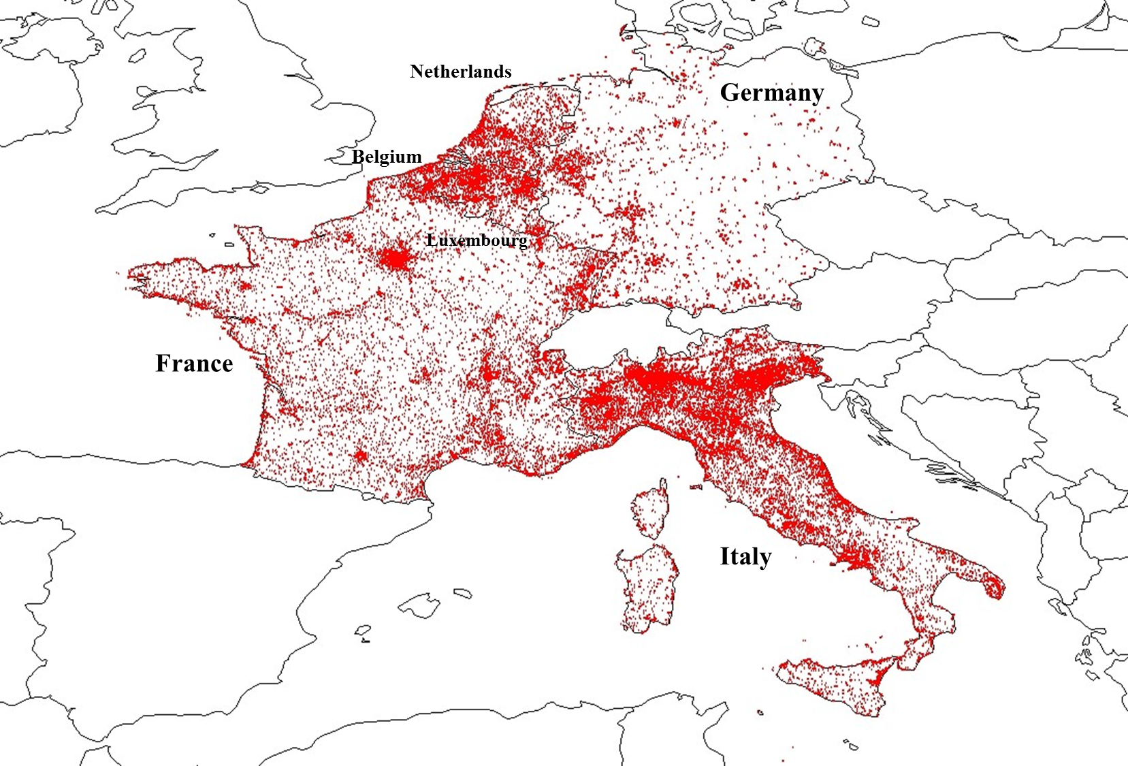
Location Map of Reviewed Restaurants in Six European Countries
Irregular Pattern of Observations!

Slide 31
Geographic Interpolation Study: Open New Restaurants in Unobserved Area!
Mean Absolute Error (MAE) Comparison using a 20% Holdout Sample with the EU Restaurant Data
 | Collaborative Filtering (Nations-level) | Collaborative Filtering (Counties-level) | Spatially Dependent Segmentation (K=4) | Traditional GWR | The proposed HBGWR Model
MAE | 0.367 | 0.359 | 0.349 | 0.202 | 0.189
For two CF, a cosine-based similarity with 5 restaurant characteristics (e.g., price level, the number of cuisine category, coverage of meals, binary family restaurant, and binary takeout) for computing a weighted sum of overall satisfaction of neighbor regions.
For SDS, segment-level membership has been used to interpolate satisfaction in unobserved locations.
For GWR and HBGWR, we ran models with setting zeros to the target (holdout) locations.

Slide 32
Mean of Estimated Coefficients across Six EU Countries
Countries | Food (β1) | Service (β2) | Value (β3)
Belgium | 0.379 | 0.318 | 0.19
France | 0.443 | 0.298 | 0.14
German | 0.386 | 0.286 | 0.132
Italy | 0.407 | 0.294 | 0.122
Luxembourg | 0.432 | 0.313 | 0.128
Netherlands | 0.357 | 0.3 | 0.165
Spatial Heterogeneity of key drivers across different nations:
For Food: France shows highest coefficients; Netherlands provides lowest coefficients.
For Service: Belgium shows highest coefficients; Italy provides lowest coefficients.
For Value: Belgium provides highest coefficients; Italy provides lowest coefficients.

Slide 33
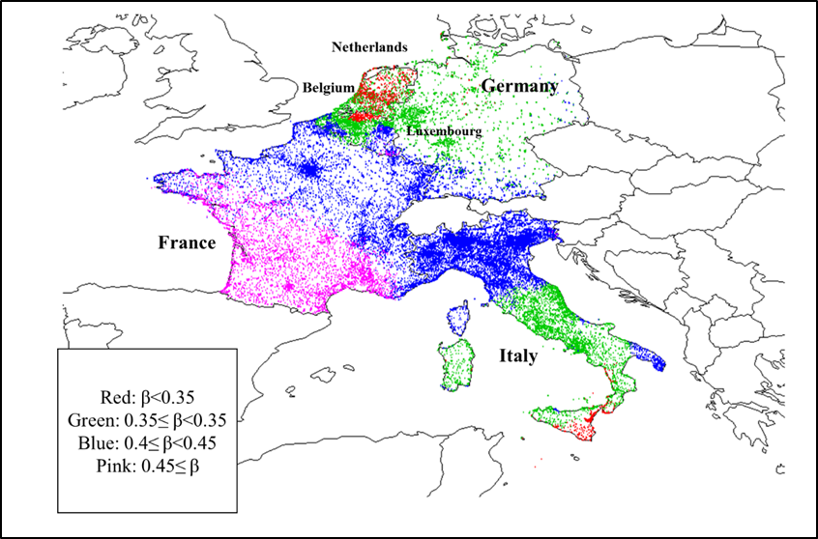
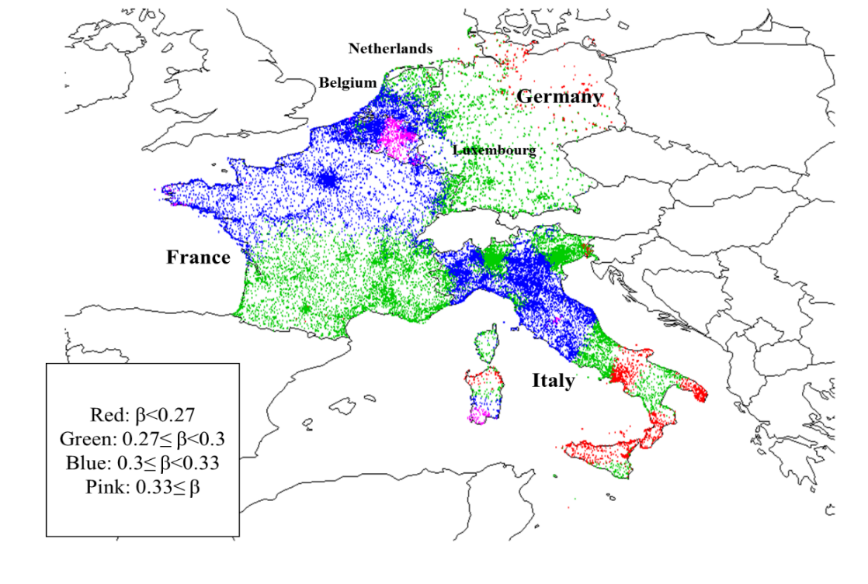
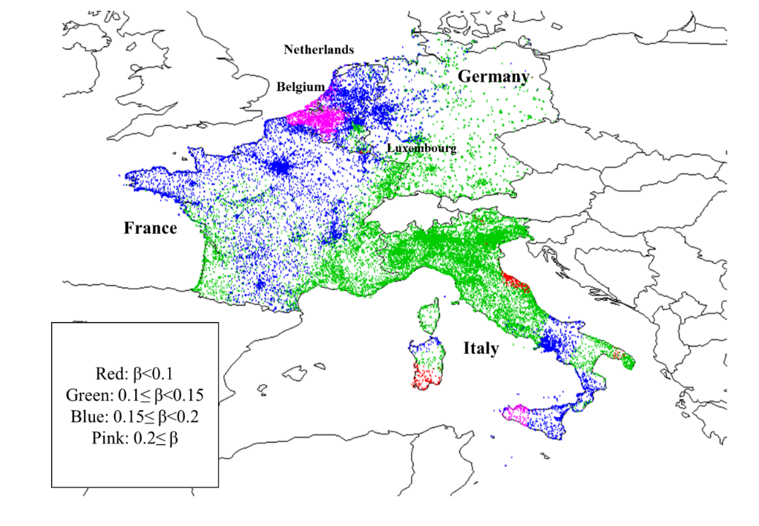
(A) Coefficients of Food
Geographically heterogeneous coefficients of EU restaurants by the proposed HBGWR model
(B) Coefficients of Service
(C) Coefficients of Value
For Food effect, France tends to be pink (higher coefficient values); Belgium and Netherlands are red (lower coefficient values).
For Service and Value, Benelux Union area (e.g., Belgium) seems pink.

